Slide 1
Diffusion Model
Principle and possibility

Slide 2





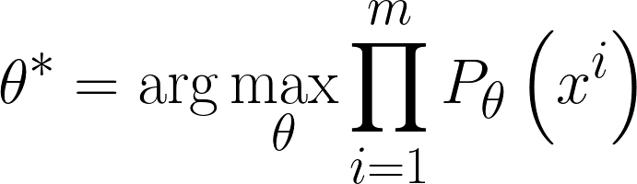
Maximum Likelihood Estimation
𝑃_{𝜃} 𝑥
^{𝑃}𝑑𝑎𝑡𝑎
𝑥
𝜃
𝑧
Network
𝑥
???
_{𝑥}𝑖
???
We can compute 𝑃
𝜃

Slide 3
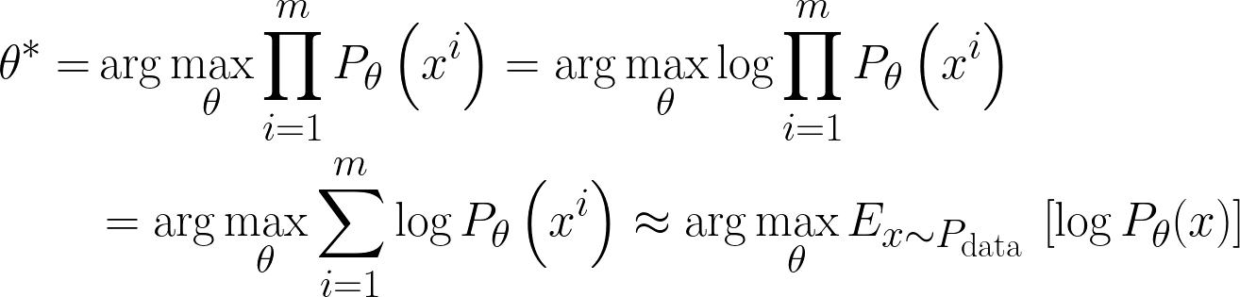
(not related to 𝜃)
Difference between 𝑃_{𝑑𝑎𝑡𝑎} and 𝑃_{𝜃}
Maximum Likelihood = Minimize KL Divergence

Slide 4


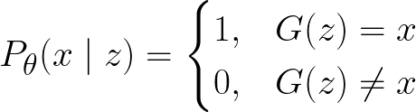


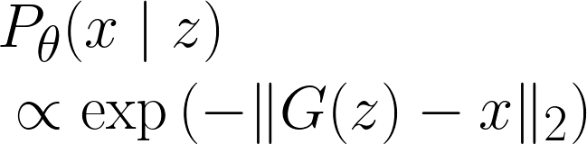



VAE: Compute 𝑃_{𝜃}(𝑥)
𝑃_{𝜃} 𝑥
𝜃
𝑧
Network
𝑥
Most likely be 0
𝑧
Network
Mean of Gaussian

Slide 5
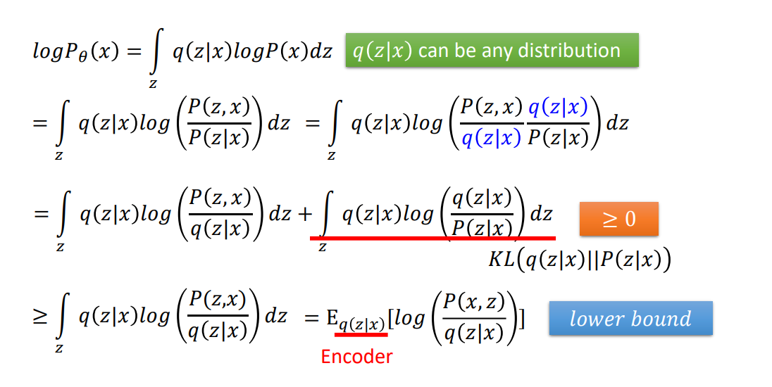
hat is Data
VAE: Lower bound of logP(x)
Item 1
Descriptive content
Item 2
Descriptive content
Sub item

Slide 6




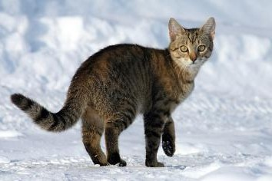


DDPM: Compute 𝑃_{𝜃}(𝑥)
Denoise
Denoise
……
𝑥_{𝑇}
^{𝑥}𝑇−1
𝑥₀
Mean of Gaussian
Denoise
G(x_{t})
𝑥_{𝑡}

Slide 7
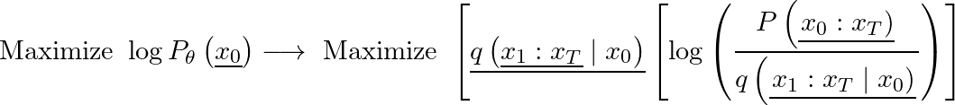
DDPM: Lower bound of 𝑙𝑜𝑔𝑃(𝑥)
VAE
Encoder
DDPM
Forward Process
(Diffusion Process)

Slide 8


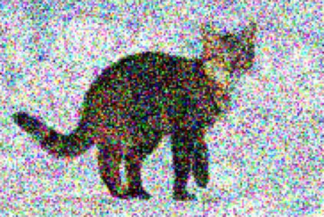



~𝒩(𝟎, 𝐼)
=
1 − 𝛽_{𝑡}
+
𝛽_{𝑡}
^{𝑥}𝑡−1
𝑥_{𝑡}
𝛽₁, 𝛽₂, … , 𝛽_{𝑇}
……
𝑥₀
+
+
+
𝑥_{𝑡}

Slide 9

~𝒩(𝟎, 𝐼)
=
1 − 𝛽₁
+
𝛽₁
𝑥₁
𝑥₀
~𝒩(𝟎, 𝐼)
=
1 − 𝛽₂
+
𝛽₂
Ind.
𝑥₂
𝑥₁
=
1 − 𝛽₂
1 − 𝛽₁
𝑥₂
𝑥₀
+
1 − 𝛽₂ 𝛽₁
+
𝛽₂

Slide 10

~𝒩(𝟎, 𝐼)
~𝒩(𝟎, 𝐼)
=
1 − 𝛽₂
1 − 𝛽₁
𝑥
2
𝑥₀
+
1 − 𝛽₂ 𝛽₁
+
𝛽₂
~𝒩(𝟎, 𝐼)
+
1 − 1 − 𝛽₂
1 − 𝛽₁

Slide 11
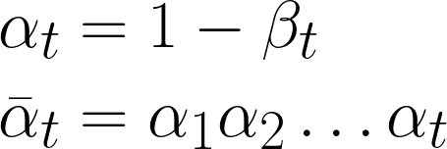




=
1 − 𝛽₁
+
𝛽₁
𝛽₁, 𝛽₂, … , 𝛽_{𝑇}
=
1 − 𝛽₂
+
𝛽₂
…
…
…
~𝒩(𝟎, 𝐼)
=
1 − 𝛽_{𝑡}
+
𝛽_{𝑡}
≡
=
+

Slide 12
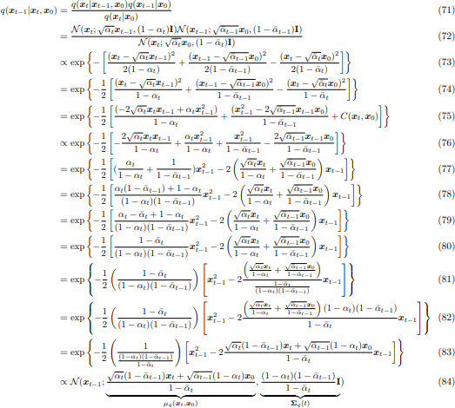
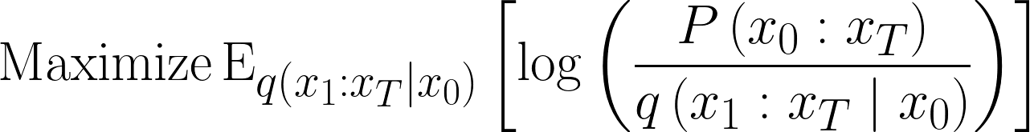
https://arxiv.org/pdf/2208.11970.pdf

